Slide 1


AI-Enabled PROJECT PREDICTION
Exploring AI’s Potential to generate new Project Ideas, suggest tools, and possible technologies
HARSHIT RAUTELA
SHIVAM RAWAT
ANURAG PARMAR
Under the guidance of Dr. Subhankar Ghosal

Slide 2
Introduction
Major/ Minor projects are one of the most important and integral part of Engineering curriculum in World, enabling students to
Furnish real world industry oriented, project development quality
Be familiar with the current trend in industry
Assimilate and invoke the innovative and research capabilities to further contribute in the field of research and development.
However generation of innumerous number of valid and interesting project ideas are a real challenge.
Solution - AI Enabled automatic generation of Project ideas using GPT (Generative Pre-trained Transformer)

Slide 3
GPT
GPT (Generative Pre-trained Transformer) is a deep learning model designed to understand and generate human-like text. It is trained on textual data to learn context, patterns, and relationships within the text, enabling it to synthesise coherent and contextually relevant responses based on given inputs.
We train GPT model on several strings containing Project Ideas, Tools and Description etc. Our goal is to predict new valid set of ideas.

Slide 4
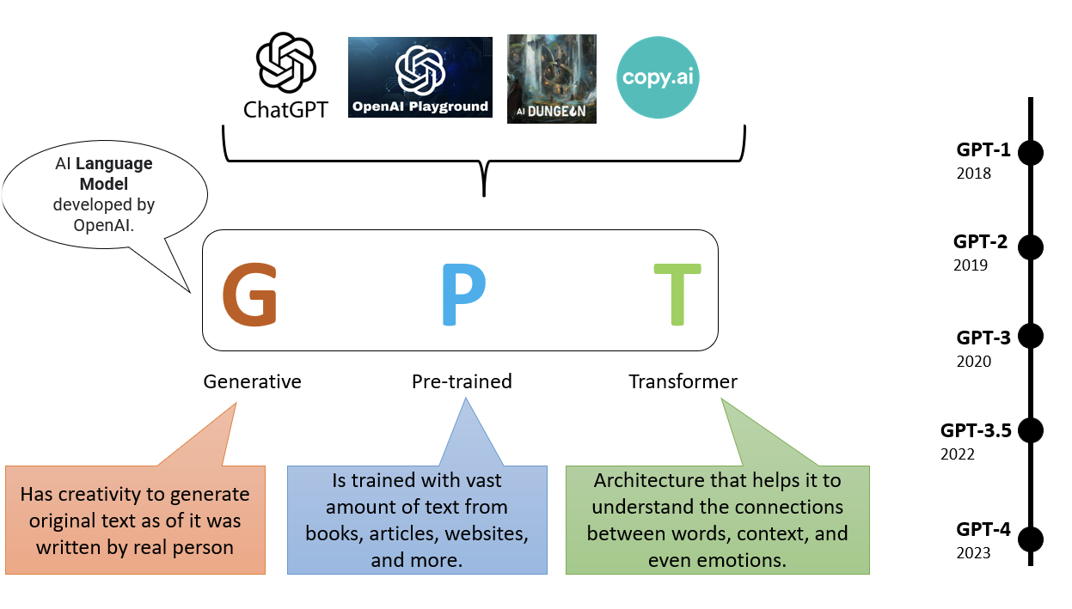
What is GPT
The Transformer is an advanced tool leveraging attention mechanisms, positional encoding, and GPU parallelism for efficient processing of sequential data.
It is pre-trained on extensive and diverse datasets, equipping it with the capability to discern complex language patterns and dependencies.
For a specific task a specialised data samples is fed to fine-tune a pre-trained model, so that specific output can be generated.
GPT in this project: The GPT-2 model was fine-tuned using input strings that included project names, descriptions, and associated tools. This fine-tuning enabled the model to generate predictions for new project concepts with greater specificity and relevance to the provided context.

Slide 5
Dataset and Preprocessing
Data Used - Project ideas, description and name of tools annotated in a specific format in a string.
Data Preprocessing
Removal of wrong string, irrelevant content.
Correction of partially correct string.
Prepare data in specific format (“Project Title: <title> Description: <description> Tools Used: <tools>”) to be fed into GPT model.

Slide 6
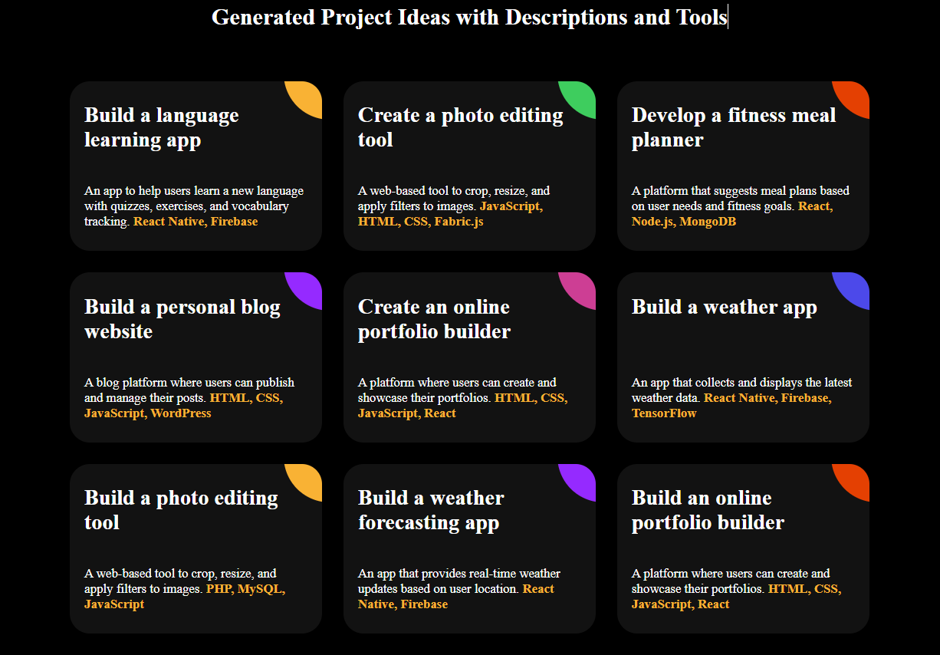
Results and Predictions

Slide 7
Future Scope
This can be a measure to solve difficulties faced by Engineering students in deciding their more innovative project.
With the innovative ideas generated by the GPT it would lead to new projects which would ultimately help in finding solutions to unsolved aspects of future living.
This can be a major topic for researcher’s for studying and finding the solutions to daily problems.

Slide 8


